Slide 1


Slide 2
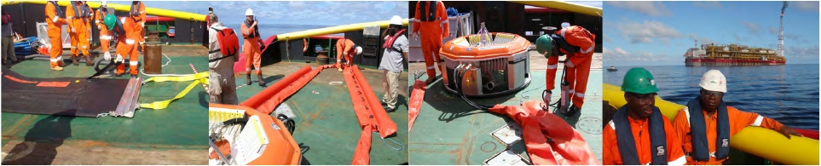
About Emco Oilfield Services
Incorporated February 2003
Commenced Business August 2003
Successful Nipex audit (30 categories), 4 DPR permits

Slide 3
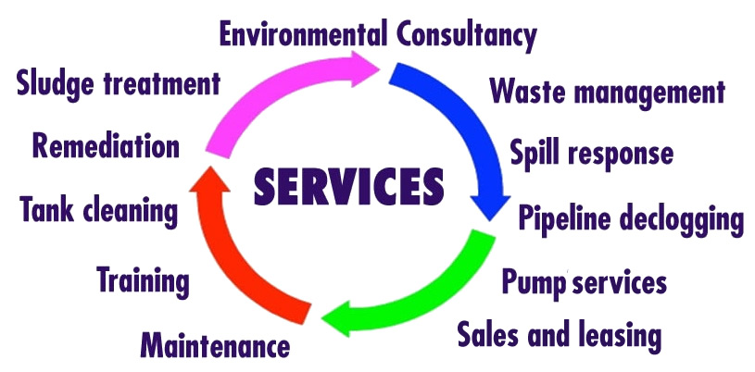
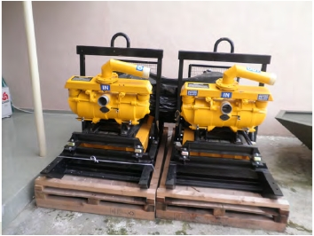
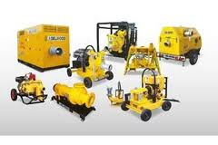
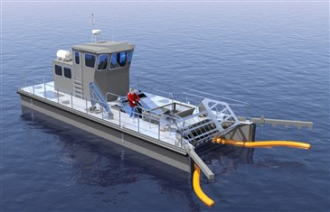
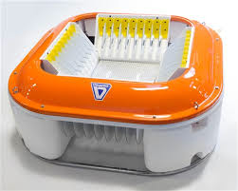
OUR SERVICES

Slide 4
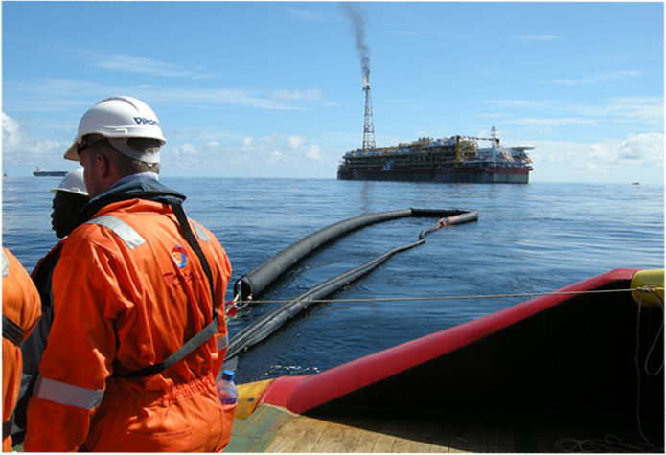
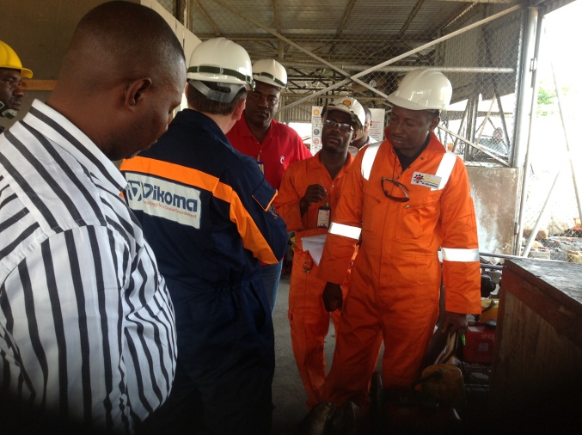
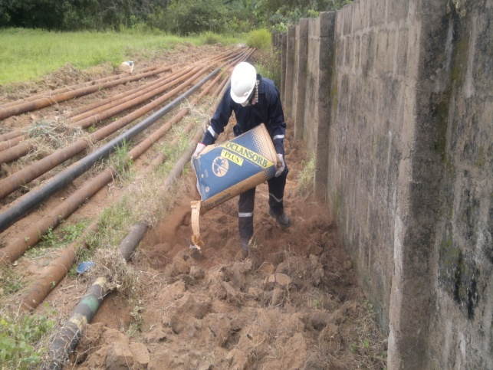
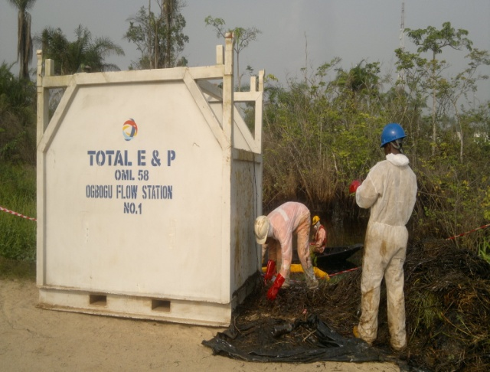
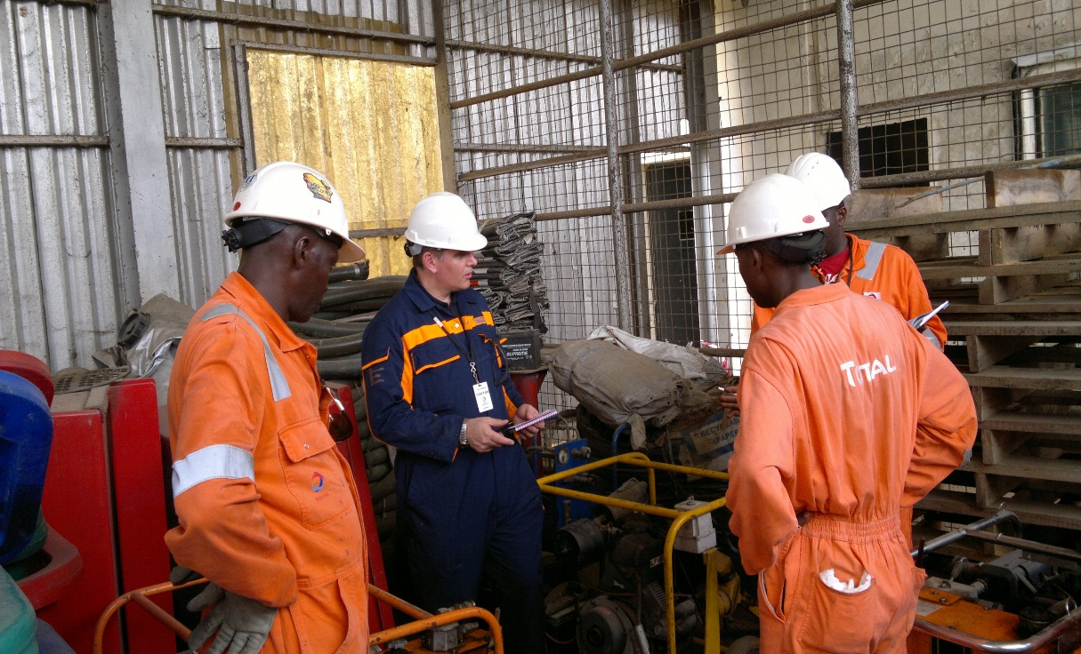
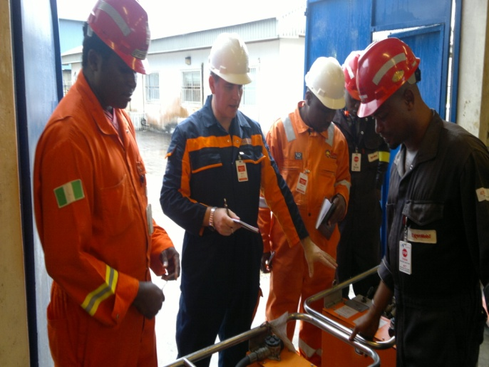
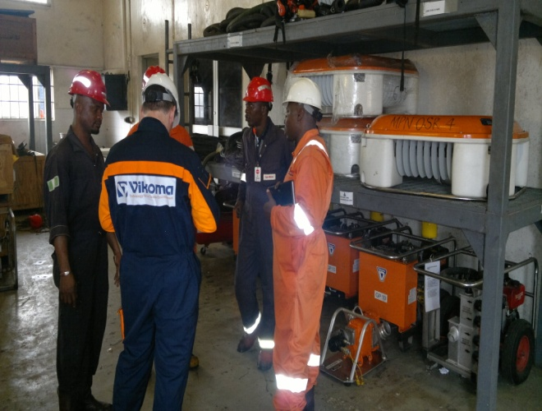
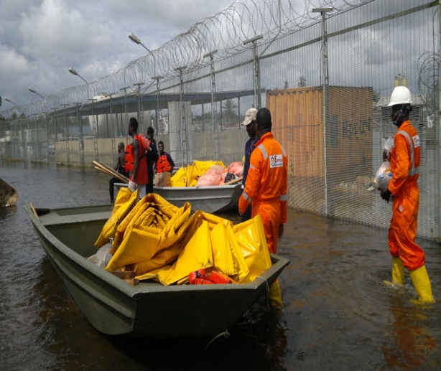
EMCO AT WORK

Slide 5

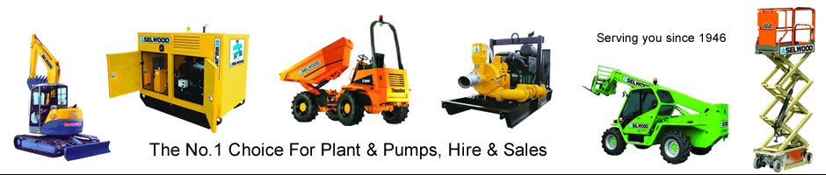


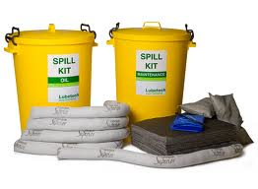


Partners
Vikoma International Limited, UK.
Selwood Pumps Limited, UK.
Lubetech, UK.
Hi Point Industries, Canada.
Nalco Environmental Solutions LLC, USA.
United Energy Corps, USA. (KX 100 HP-1)
Dorman Long Engineering LTD.

Slide 6
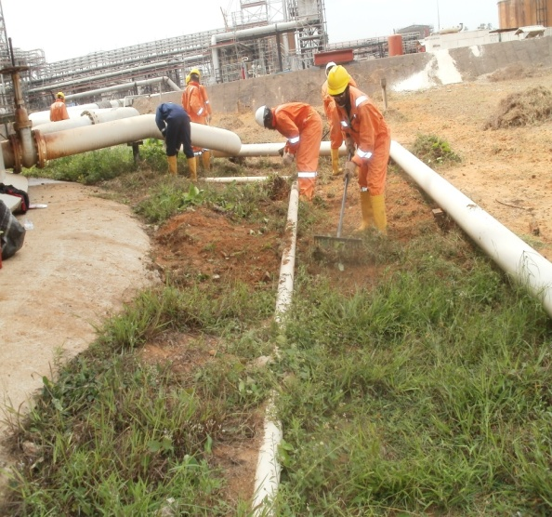
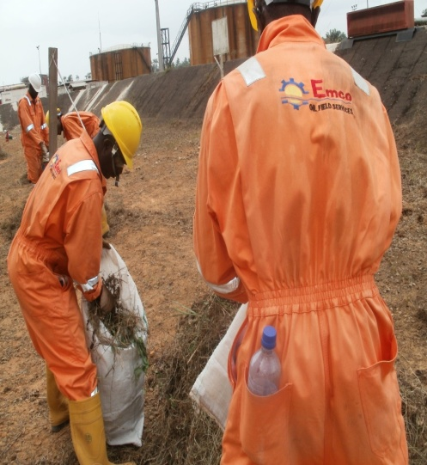
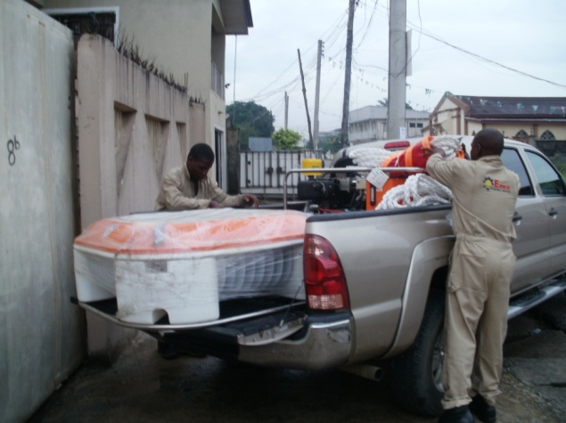
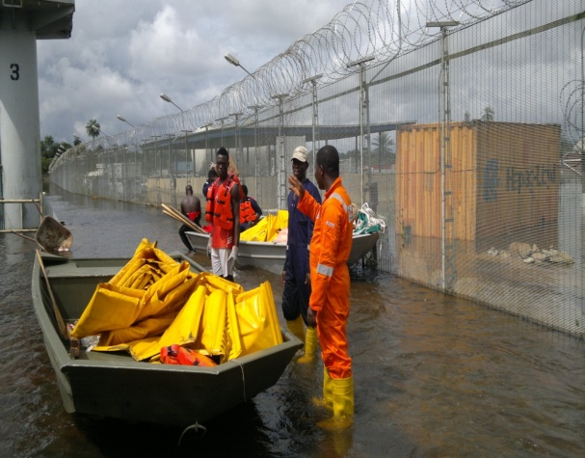
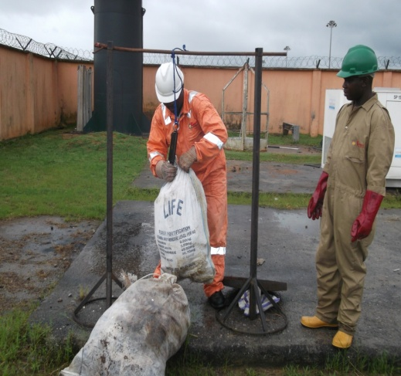
Size
44 Staff Total
5 Senior Management
4 Accounting
4 Logistics
3 Business Development
1 Internal Sales
27 Field operators

Slide 7
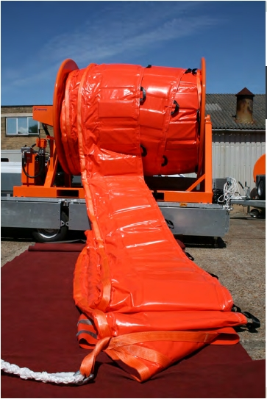
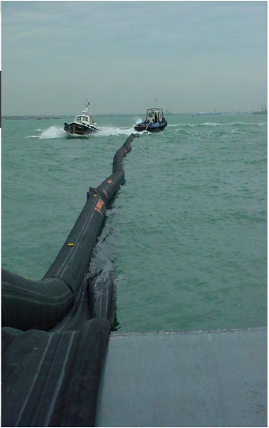
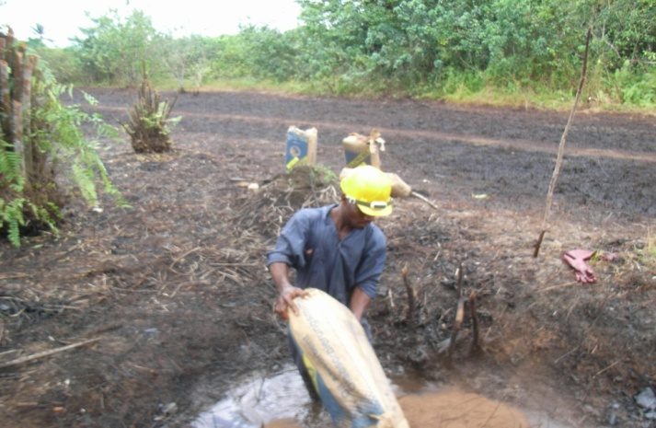
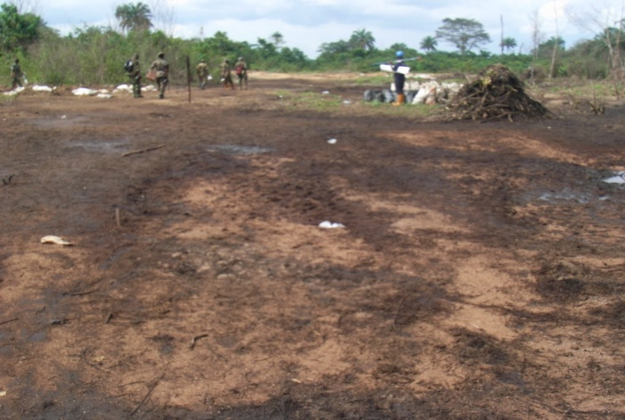
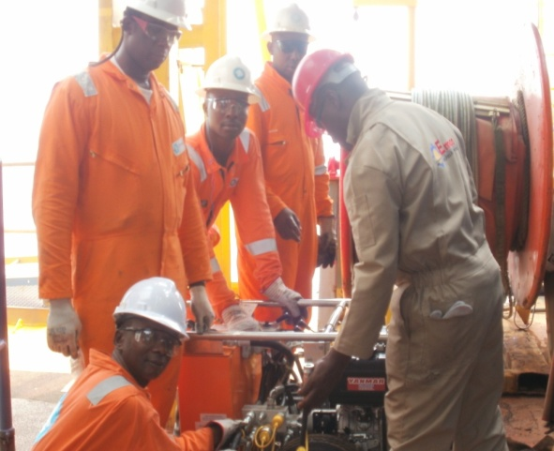
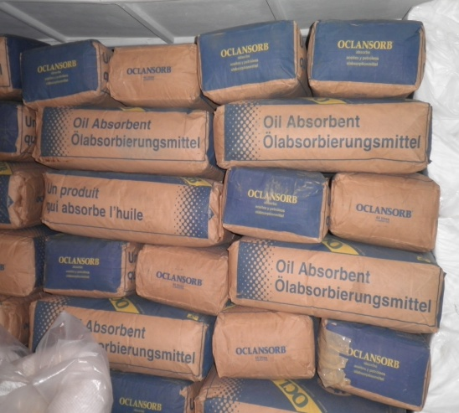
Locations in Nigeria
Port Harcourt Office
8B Bolo Street, ‘D’ Line, Port Harcourt.
Lagos Office
29 Olanrewaju Street, Off Billings Way
Oregun – Ikeja

Slide 8




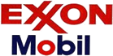


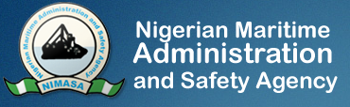



Clients
SPDC
Total E&P
Exxon Mobil
NAOC
Chevron
CNA
Monipulo
Addax
NNPC
NIMASA
NPA

Slide 9
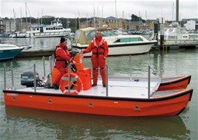
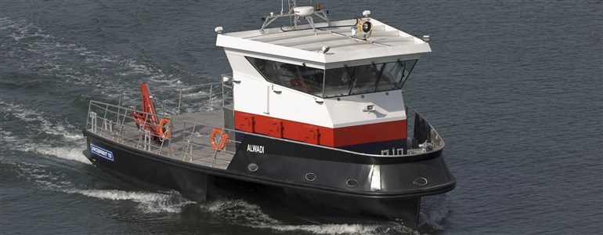
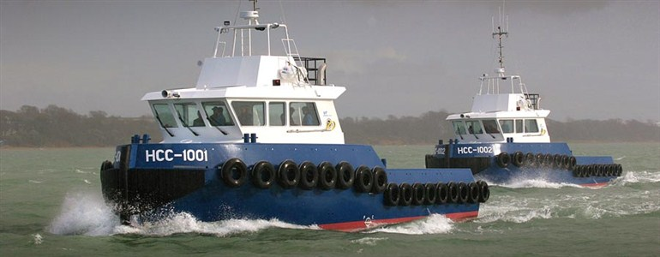
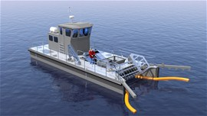
Response boats and vessels
Spillcat:
Boom deployment, dispersant spraying, oil recovery and beach clean-up operations.
Vikosprint:
Oil spill recovery vessel complete with on-board recovery system and rigid booms.
Multi Role Vessels (MRV's):
Supplied with hydraulic cranes and oil containment boom system.
Envirocat:
For oil spill recovery scenario designed for easy transportation and deployment with the ability to operate in shallow water, it also has the potential to operate alongside terminals etc.

Slide 10
Questions

